Slide 1
The Heidelberg Spiking Datasets for the Systematic Evaluation of Spiking Neural Networks
Benjamin Cramer , Yannik Stradmann , Johannes Schemmel, and Friedemann Zenke

Slide 2
Introduction
The transformation step (from image to spikes, in the case of MNIST) puts comparability at risk by leaving fundamental design decisions to the modeler.
Existing benchmarks may be tailored to the features of the published network, hence cannot be used as a general dataset for comparison. It is also possible that for some dataset, maximum precision has been achieved (saturation).
Other problems include extensive preprocessing, and may exist unpublished or behind a paywall.

Slide 3
Introduction
Thus the proposed datasets, have to be:
Unsaturated
Require minimal pre-processing
Sufficiently general
Easy to obtain
Free to use

Slide 4
Methods - datasets
The proposed datasets, spike-based classification data sets from audio data, are:
Heidelberg digits
Speech commands

Slide 5
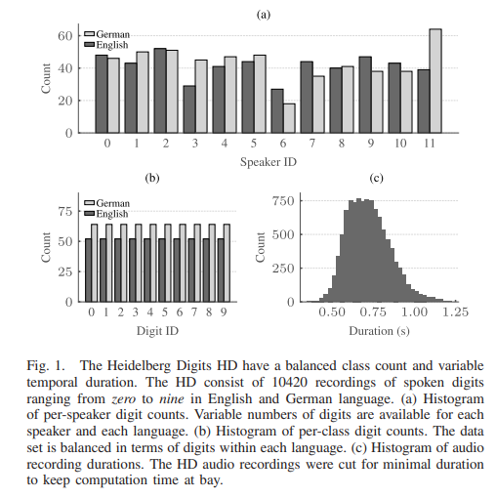
dataset - HD
The numbers 0 to 9 in English and German. 12 speakers (6 male and 6 female), with median age of 29.9 years. The recorded audio was cut and mastered. The final digit files differ in duration due to speaker differences.
2 speakers (4 and 5) were exclusive kept for testing set, and the rest were randomly picked from the training set to increase generality.

Slide 6
dataset - SC
Contains words spoken by 1864 speakers.
The words included are- Yes, No, Up, Down, Left, Right, On, Off, Stop, Go, Backward, Forward, Follow, Learn, Zero, One, Two, Three, Four, Five, Six, Seven, Eight, Nine, repeated 5 times per speaker, and auxiliary words Bed, Bird, Cat, Dog, Happy, House, Marvin, Sheila, Tree, and Wow repeated only once.
Partitioning into training, testing, and validation data set was done by a hashing function.

Slide 7
Methods – spike conversion
The inner-ear model and the ascending auditory pathway approximates the spiking activity observed in the auditory system while retaining a low computational cost.
The biologically inspired conversion allowed sidestepping the issue of user-specific audio-to-spike transformation, which can confound comparability, and served as the basis for the benchmark data sets.

Slide 8
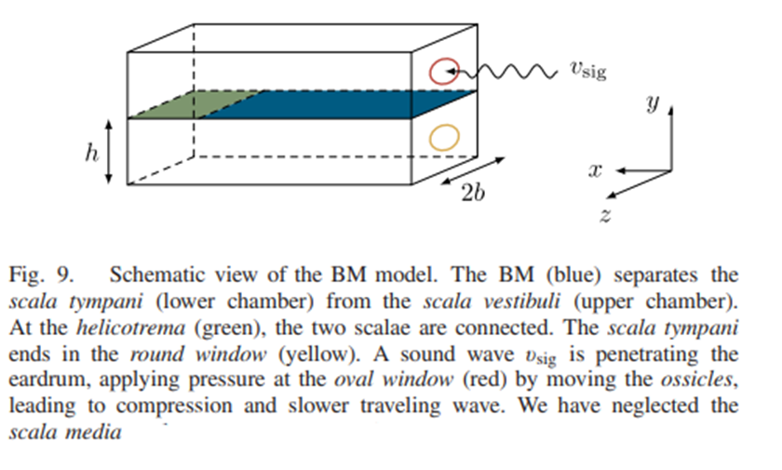
Spike conversion - Basilar Membrane Model
A fundamental aspect of a cochlea model is the interaction between a fluid and a membrane causing spatial frequency dispersion.
Assumption- the fluid is inviscid (zero viscosity) and incompressible. Furthermore, we expect the oscillations to be small that the fluid can be described as linear.
This causes spatial frequency dispersion.

Slide 9
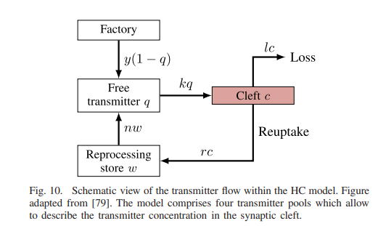
Spike conversion - hair cell
These separated frequencies are converted to instantaneous firing rates through a biologically motivated transmitter pool based hair cell.
In the HC model, one assumes that the cell contains a specific amount of free transmitter molecules q(x,t) which could be released by use of a permeable membrane to the synaptic cleft.
k – permeability of membrane
c – amount of transmitter in the cleft , r.c – amount reuptaken from cleft
w – reuptaken transmitter, n.w – fraction of reuptaken transmitter into q
y(1-q) – manufacturing new transmitters
P_{spike} = h.c – probability that the transmitter affects the post-synaptic cell
l.c – loss of transmitter through diffusion

Slide 10
Spike conversion - Bushy Cell Model
A layer of bushy cells increase phase locking.
The phase-locking of HC outputs was increased by feeding their spike output to a population of N_{ch} BCs. Implementation of the BCs was done as standard single layer LIF neuron model, with no recursion. The feed forward weights were set to W = 0.54 per connection among the bushy cells.
A single BC was used to integrate the spike trains of the N_{HC} = 40 HCs for each channel of the BM.

Slide 11
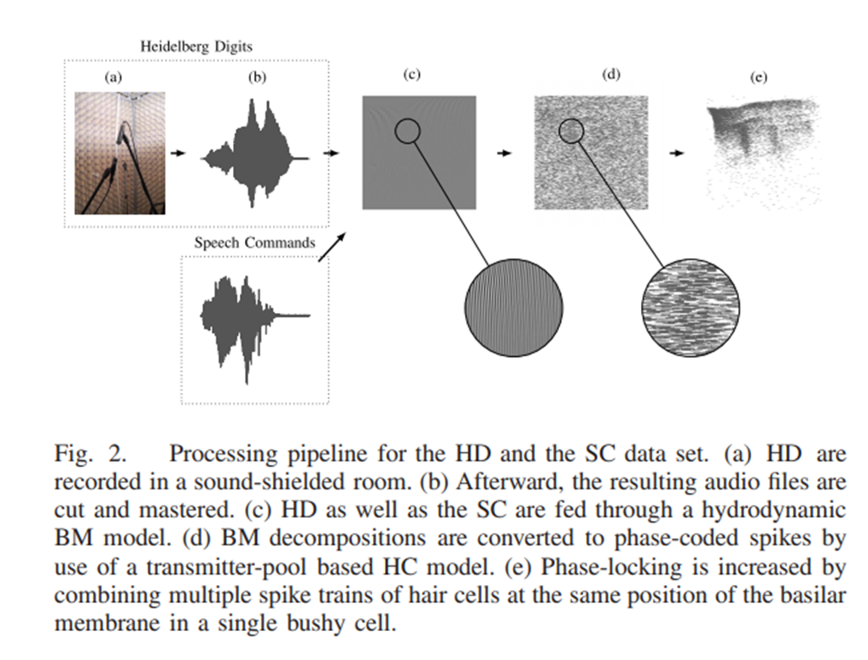
Spike conversion – bushy cell

Slide 12
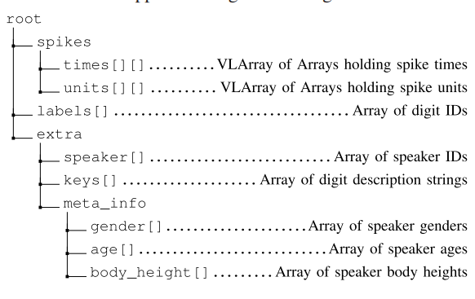
Methods - Event-Based Data Format
Hierarchical Data Format 5 (HDF5) was used.

Slide 13
Methods - network model
Training networks of leaky integrate-and-fire (LIF) neurons with surrogate gradients and backpropagation through time (BPTT) using supervised loss functions to establish a performance reference on the two spiking data sets.
The spike trains emitted by the N_{ch} = 700 BCs were used to stimulate the actual classification network. Each hidden layer contained N = 128 LIF neurons. For all network architectures (feed forward and recurrent), the last layer was accompanied by a linear readout consisting of leaky integrators which did not spike.

Slide 14







Model – neuron and synapse
u_{leak} = 0 and u_{thres} = 1

Slide 15
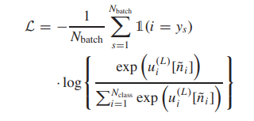
Model - loss
For the readout layer, cross entropy loss was applied.
For the max-over-time loss, the time step with maximal membrane potential for each readout unit was considered ˜n_{i} = argmaxn u^{(L)} [n _{i} ].
The last time step T for all samples was chosen for each readout neuron ˜n_{i} = T in case of the last-time-step loss.
Minimized the loss using the Adam optimizer.

Slide 16
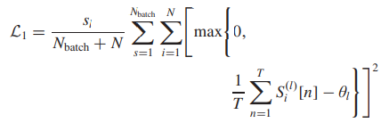

Model - regularization
Added synaptic regularization terms to the loss function to avoid pathologically high or low firing rates.
As a first term, a per neuron lower threshold spike count regularization, given by L1, was used, with strength s_{l}, and threshold θ_{l}. Second, an upper threshold mean population spike count regularization with strength s_{u} , and threshold θ_{u} given by L2 was used.

Slide 17
results
To test that the proposed datasets were not already saturated, and that the spike timing was an important aspect for high accuracy of the dataset, the authors used a reduced version of the dataset removing the temporal information.
The spike count patterns was computed to achieve this.
Various linear and non-linear SVMs, LSTMs and CNNs were trained using the reduced version of both datasets.

Slide 18
Results - SVM
A linear SVM readily overfitted the data in the case of SHD, its test performance only marginally exceeded the 55% accuracy. For the spiking speech commands (SSC), overfitting was less pronounced, but the overall test accuracy dropped to 20%. Thus, linear classifiers provided a low degree of generalization.
SVMs with polynomial kernels up to a degree of 3 were trained for a second opinion. For these kernels, overfitting was less pronounced. Slightly better performance of about 60% on the SHD and 30% on the spiking SC (SSC) was achieved when using a SVM with a radial basis function (RBF) kernel.

Slide 19
Results - SVM
The performance on the SHD test set, for polynomial and RBF kernels was worse than for the linear kernel in terms of generalization across speakers .
In contrast, the performance on the SSC test set to be on par with the accuracy on the validation set which is most likely an effect of the uniform speaker distribution.
Both linear and nonlinear classifiers trained on spike count patterns without temporal information were unable to surpass the 60% accuracy mark for the SHD and the 30% mark for the SSC data set.

Slide 20
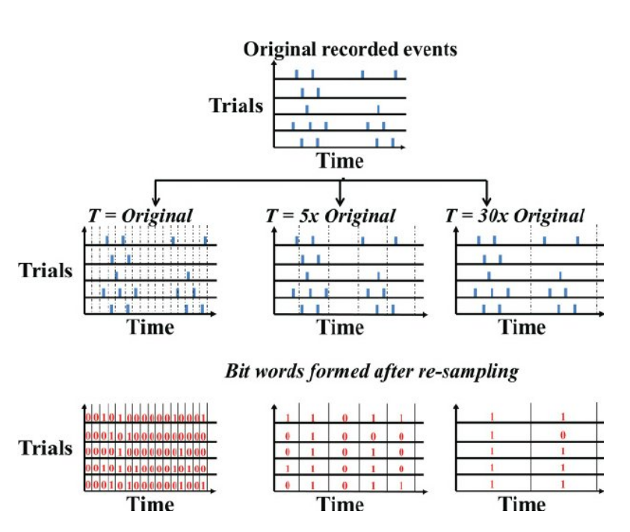
Binning
For LSTMs and CNNs, the input spikes were binned into bins of 10 ms.

Slide 21
Result - lSTM
To check whether decoding accuracy could be improved when training classifiers that have explicit access to temporal information of the spike times, LSTMs were trained.
In spite of the small size of the SHD data set, LSTMs showed reduced overfitting and were able to solve the classification problem with an accuracy of 85.7%.
Similarly, for the SSC data set the LSTM test accuracy 75.0%.
the degree of overfitting was slightly higher than on SHD

Slide 22
Result - cnn
Since overfitting was a problem with SVMs and LSTMs, CNNs were trained.
CNNs showed the least amount of overfitting among all tested classifiers; the accuracy dropped by only 1.4% on SHD and by 1.5% on SSC.
the performance on the SHD test data was on par with the one on the validation set, demonstrating a high degree of generalization.
Therefore the temporal information contained in both data sets can be exploited by suitable neural network architectures. These results provide a lower bound on the performance ceiling for both data sets.

Slide 23
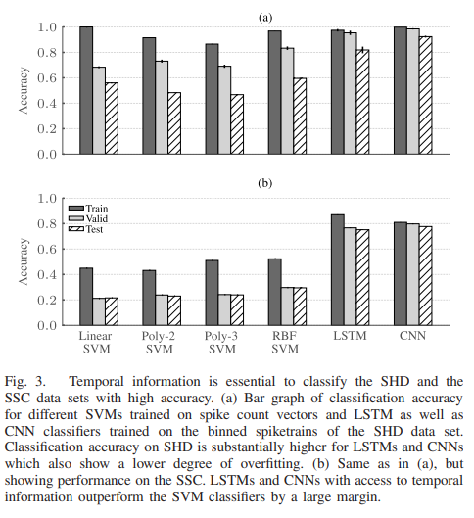
results

Slide 24
Results - Training Snn
SNNs were trained using BPTT and Surrogate Gradient descent (fast sigmoid function as a substitute) method.
SNNs with fixed and finite time constants were used, in the scale of ms.
The performance of LSTMs and SNNs for both described loss functions was compared for SHD.
The slightly reduced performance of feed-forward SNNs trained with last time-step loss compared to recurrently connected spiking neural networks (RSNNs) suggests that time constants were too low to provide all necessary information at the last time step. This was due to active memory implemented through reverberating activity through the recurrent connections.

Slide 25
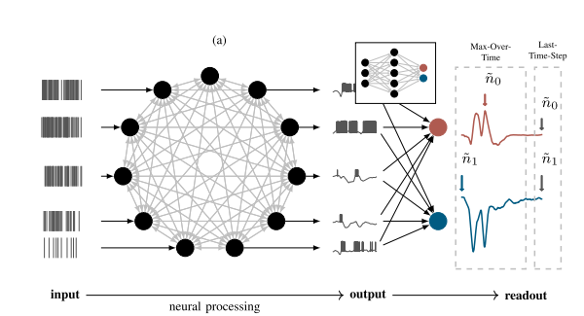
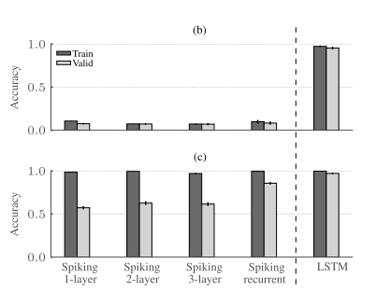
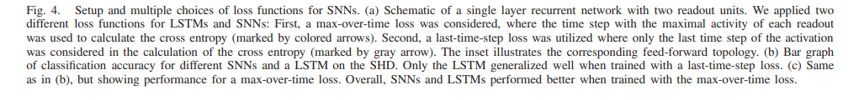

Slide 26
Results - training Snn
Since max over time loss gave better results, further experiments were conducted using the same for SHD.
For optimising the parameter β for steepness, a grid search between β and η (learning rate) based on a single-layer RSNN on SHD.
Only for small β the accuracy dropped dramatically, whereas it decreased only slowly for high values. Learning rate did not have major affects on the peak performance.
Optimal values: β = 40 and η = 0.001, performance reached peak for 150 epochs.

Slide 27
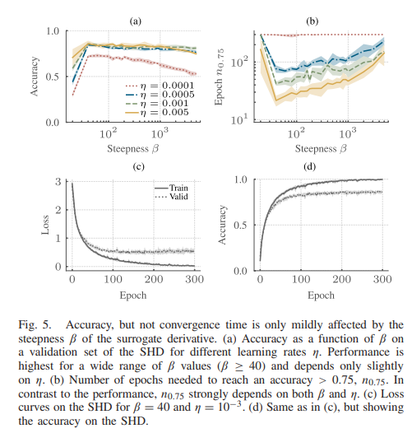
Results - training Snn

Slide 28
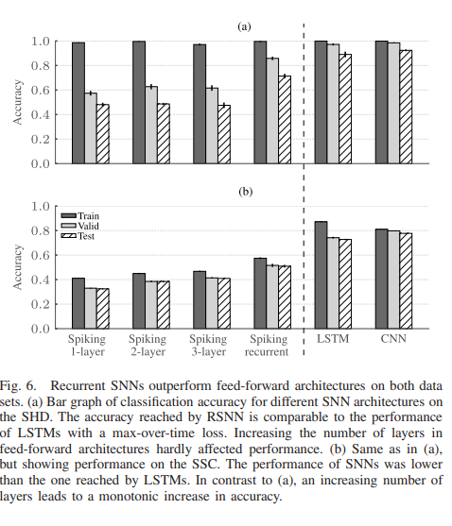
Results - training Snn
The RSNN achieved the highest accuracy of 71.4% on the SHD and 50.9% on the SSC which was still less than the LSTM with 85.7% on the SHD and 75.0% on the SSC.

Slide 29
Results - Generalization (Across Speakers)
For robust spoken word classification, the generalization across speakers is a key feature. This generalization can be assessed by evaluating the accuracy per speaker on SHD, as the digits spoken by speakers four and five are only present in the test set.
Comparison of the performance on the digits of the held-out speakers to all other speakers was done and a clear performance drop across all classification methods for the speakers four and five was found.
This illustrates that the composition of the test set of SHD can provide meaningful information with regard to generalization across speakers.

Slide 30
Results - Generalization (Across Data Sets)
Because English digits are part of both data sets, testing the generalization across data sets was possible, by training SNNs, LSTM and CNNs on the full SHD data set while testing on a restricted SSC data set and vice versa.
For testing, the data sets were restricted to the common English digits zero to nine.
Networks generalized better, when trained on the larger SSC data set as a reference and tested on SHD. Nevertheless, all architectures trained on the SHD and tested on the SSC reached performance levels above chance.

Slide 31
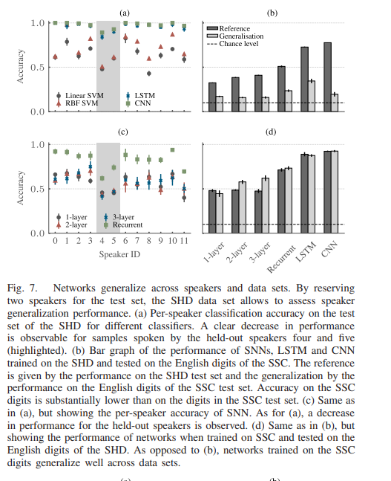

Slide 32
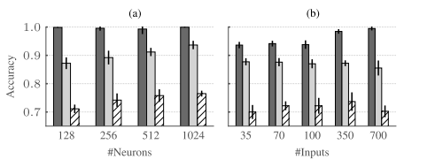
Results - Improving Generalization Performance (network size)
It was found that increasing the network size up to 1024 neurons indeed resulted in improved validation and test accuracy up to 76.5% with 1024 neurons.

Slide 33

Results - Improving Generalization Performance (data augmentation)
Next, the input was compressed in terms of channels, since a similar modification led to good results for the CNNs. Coarse-graining the inputs by condensing the spike trains of neighboring input units caused increase in accuracy.

Slide 34
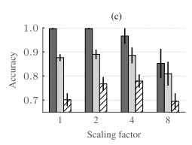
Results - Improving Generalization Performance (data augmentation)
Next, rescaled all neuronal time constants in the network.
For a scaling factor of 4 corresponding to τ_{mem} = 80 ms and τ_{syn} = 40 ms, the manipulation led to a marked reduction of overfitting that also resulted in a higher test accuracy of 79.9%

Slide 35
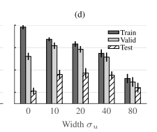
Results - Improving Generalization Performance (noise injection)
Another method to reduce overfitting is to inject noise at the input layer. This was done by implementing a event-based spike jitter across channels by adding a random number N(0, σ_{u}) to the unit index i of every input spike, which was then rounded to the nearest integer.
When combined, the aforementioned strategies resulted in a further improved best effort test accuracy of 83.2% on the SHD test set.

Slide 36
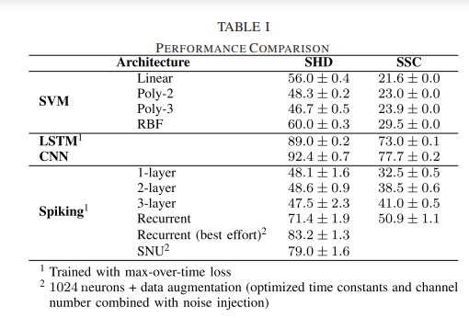
results
Spiking neural units (SNUs) feature delta synapses and rely on a different surrogate derivative.

Slide 37
Discussion
The authors chose audio data sets as the basis for their benchmarks because audio has a temporal dimension which makes it a natural choice for spike-based processing. However, in contrast to movie data, audio requires fewer input channels for a faithful representation, which renders the derived spiking data sets computationally more tractable.
Analysis of the SHD and the SSC using LSTMs and SNNs showed that the choice of loss functions can have a marked effect on classification performance. While LSTMs perform best with a last-time-step loss, in which only the last time step is used to calculate the cross entropy loss, SNNs achieved their highest accuracy for a max-over-time loss, in which the maximum membrane potential of each readout unit is considered.

Slide 38
Discussion
The temporal information available in the spike times can be leveraged for better classification by suitable classifiers. Moreover, architectures with explicit recurrence, like LSTMs and RSNNs, were the best performing models among all architectures tested.
There exists a plethora of alternative gradient-based approaches based on network translation, single spike timing , mean firing rate, and stochastic approximations. Furthermore, there are biologically inspired online approximations of surrogate gradients and, finally, a body of work has used biologically motivated spike timing dependent plasticity (STDP)-like learning rules.

Slide 39
